Slide 1
Self-identifying the mental health status and get guidance for support.
Aayush Ajit Srivastava
CLOUD BASED APPLICATION
CBA09

Slide 2
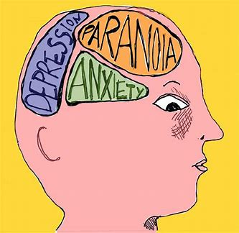
Understanding mental health
mental health is a state of well-being in which an individual is able to cope with the normal stresses of life, work productively, and make a contribution to their community.
mental health is not just the absence of mental illness, but a positive state of being that can be achieved by taking care of one's overall well-being.
the importance of identifying and addressing mental health concerns early on, as early intervention can improve outcomes and prevent the condition from worsening.

Slide 3
Signs and symptoms of common mental health conditions
A list of common mental health conditions, such as:
Depression
Anxiety
Post-traumatic stress disorder (PTSD)
Bipolar disorder
Schizophrenia
Eating disorders
Individuals should observe themselves and take appropriate test is they find any of the symptoms in them.

Slide 4
Self-assessment
Explain that self-assessment can help individuals identify their own mental health status and determine whether they should seek professional help.
Provide a list of self-assessment tools and resources, such as:
Online quizzes and assessments
Journaling prompts
Mental health screening tests
Encourage individuals to use these resources to gain a better understanding of their mental health and identify any concerns.

Slide 5
CONCLUSION
Mental health is an important aspect of overall well-being and that seeking professional help early on can improve outcomes.
Take an active role in their mental health and to use the resources provided in the presentation to identify and address any concerns.

